Slide 1
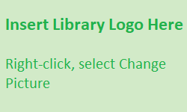
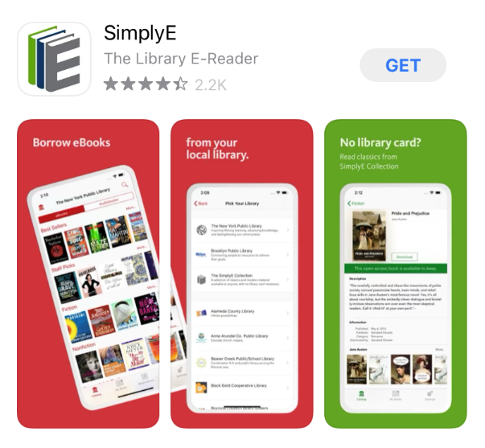
SimplyE for Apple Devices
What is SimplyE?
SimplyE is a free app that allows you to search Library Name’s eBook and audiobook collection across multiple sources, all at the same time, and download them to your Apple iPhone or iPad.
You will need an Apple device (iOS 10.0 or later), and a valid library card number and password.
SimplyE is not compatible with Kindle or Nook devices.
Getting Started
Install the App
Open the App Store app and search for SimplyE
Tap Get, then open the SimplyE App
Tap Agree to accept the Terms of Service
Log In to your Library
Open SimplyE and tap Settings in the bottom-right corner
Tap Accounts, then Add Library
Locate and tap Library Name in the list
Tap Library Name
Enter your library card number and password/PIN
Tap Log in
Select Your Library’s Catalog
Tap the Catalog icon in the upper-left corner
Select Library Name from the list
The library’s catalog will appear


